Slide 1
Unit 2
Basics of c programming

Slide 2
General structure of ‘C’ program
A C program is divided into different sections. There are six main sections to a basic c program.
The six sections are,
Documentation
Link
Definition
Global Declaration
Main Function
Subprogram

Slide 3
Documentation Section
The documentation section is the part of the program where the programmer gives the details associated with the program. He usually gives the name of the program, the details of the author and other details like the time of coding and description. It gives anyone reading the code the overview of the code.
Example
/**
* File Name: Helloworld.c
* Author: Naik
* Date: 09/08/2019
* Description: a program to display hello world
*/

Slide 4
2. Link Section
This part of the code is used to declare all the header files that will be used in the program. This leads to the compiler being told to link the header files to the system libraries.
Example
#include<stdio.h>
#include <conio.h>
#include <math.h>

Slide 5
Definition Section
In this section, we define different constants. The keyword define is used in this part.
#define PI=3.14

Slide 6
Global Declaration Section
This part of the code is the part where the global variables are declared. All the global variable used are declared in this part. The user-defined functions are also declared in this part of the code.
float area(float r);
int a=7;

Slide 7
Main Function Section
Every C-programs needs to have the main function. Each main function contains 2 parts. A declaration part and an Execution part. The declaration part is the part where all the variables are declared. The execution part begins with the curly brackets and ends with the curly close bracket. Both the declaration and execution part are inside the curly braces.
int main(void)
{
int a=10;
printf(" %d", a);
return 0; }

Slide 8
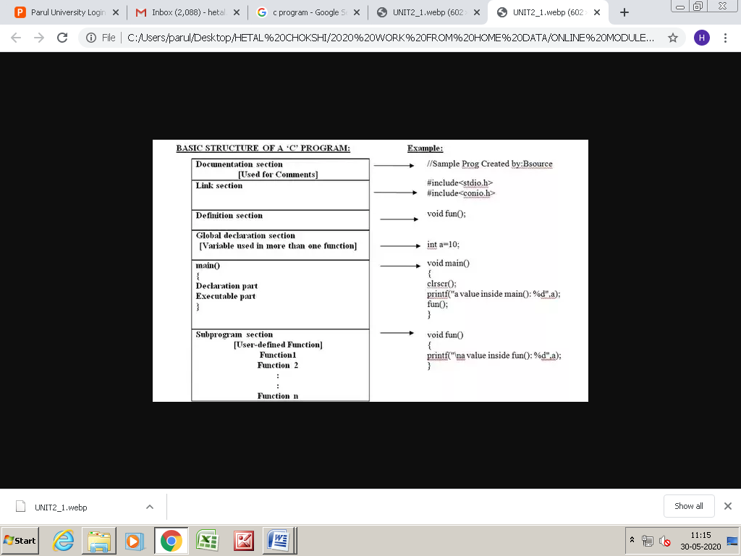
Sub Program Section
All the user-defined functions are defined
in this section of the program.
int add(int a, int b)
{
return a+b;
}

Slide 9
C ADVANTAGES
Building block for many other programming languages
C is considered to be the most fundamental language that needs to be studied if you are beginning with any programming language. Many programming languages such as Python, C++, Java, etc are built with the base of the C language.
Powerful and efficient language
C is a robust language as it contains many data types and operators to give you a vast platform to perform all kinds of operations.
Portable language
C is very flexible, or we can say machine independent that helps you to run your code on any machine without making any change or just a few changes in the code.
Built-in functions
There are only 32 keywords in ANSI C, having many built-in functions. These functions are helpful when building a program in C.

Slide 10
Conti…
Quality to extend itself
Another crucial ability of C is to extend itself. We have already studied that the C language has its own set of functions in the C library. So, it becomes easy to use these functions. We can add our own functions to the C Standard Library and make code simpler.
Structured programming language
C is structure-based. It means that the issues or complex problems are divided into smaller blocks or functions. This modular structure helps in easier and simpler testing and maintenance.
Middle-level language
C is a middle-level programming language that means it supports high-level programming as well as low-level programming. It supports the use of kernels and drivers in low-level programming and also supports system software applications in the high-level programming language.

Slide 11
Conti…..
Implementation of algorithms and data structures
The use of algorithms and data structures in C has made program computations very fast and smooth. Thus, the C language can be used in complex calculations and operations such as MATLAB.
Procedural programming language
C follows a proper procedure for its functions and subroutines. As it uses procedural programming, it becomes easier for C to identify code structure and to solve any problem in a specific series of code. In procedural programming C variables and functions are declared before use.
Dynamic memory allocation
C provides dynamic memory allocation that means you are free to allocate memory at run time. For example, if you don’t know how much memory is required by objects in your program, you can still run a program in C and assign the memory at the same time.
System-programming
C follows a system based programming system. It means the programming is done for the hardware devices.

